Slide 1

NEW AGENT
ONBOARDING
Your Path from Hired to Producing
Summit Point Pathway | Globe Life Liberty National Division
MINDSET

Slide 2
Welcome to the Team
Congratulations on taking this step!
You have joined Globe Life Liberty National Division — one of the most merit-based career opportunities in the country.
Advancement is not based on seniority, who you know, or how long you've been here. It is based entirely on your results.
The career track is real: Career Agent → Supervising Agent → General Agent → Agency Director → Agency Owner. You set the pace.
Your success starts NOW — the agents who get off to the fastest start are the ones who hit the ground studying.
I am walking with you hand-in-hand through every step of this process. I am your primary point of contact — reach out to me first.
MINDSET

Slide 3
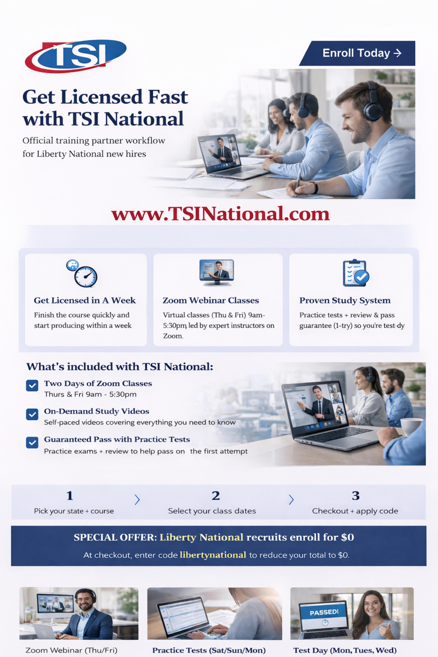
Step 1: Get Licensed — TSI National
MINDSET

Slide 4
Step 1: TSI National — How It Works
Once you are hired, your first step is TSI National — before anything else.
1
Enroll at TSINational.com
2
Complete the Coursework
3
Pass Your State Exam
Pick your state + course
Select your class dates (Thu & Fri)
At checkout, enter code: My Code
Your cost: $45
Two days of live Zoom classes (Tues & Wed or Thu & Fri, 9am–5:30pm)
On-demand study videos at your own pace
Practice tests + review sessions
Guaranteed pass system — one attempt 85%
Practice exams prepare you for test day
Test days: Monday, Tuesday, or Wednesday
Pass = you are ready for fingerprinting
The faster you pass, the faster you earn
MINDSET

Slide 5
Step 2: Fingerprinting — After You Pass Your State Exam
You passed — here's what comes next before classroom training begins.
✅
🖐
📋
🎓
Pass State Exam
Get Fingerprinted
License Issued
Classroom Training
Your TSI coursework and practice tests prepared you. Now you are officially exam-certified. Send passing results Create Account on: Pearsonvue Testing
Fingerprinting is required by the state before your license can be issued. Your AD will guide you on where and how. Identogo
Once fingerprints clear, the state issues your insurance license. Liberty National assigns your agent number. Apply and create a SIRCON account at: INDIVIDUAL LICENSE APPLICATION
Now you are ready. Classroom training begins Monday. Show up having already studied.
I will walk you through the fingerprinting process personally — where to go, what to bring, and what to expect. You are not doing this alone. Reach out to me as soon as you pass your exam.
MINDSET

Slide 6
Step 3: Proven Training System
CLASSROOM TRAINING
FIELD TRAINING
ONLINE TRAINING
Presentations & Products
Scripts: GK, 30-Second Commercial, FEOs, BEOs
Modules 1–4
Section 125 & Enrollment Process
Presentations & Rebuttals
Observation to Full Participation
EPIC Activity Logging
Release Meeting / Certification
Continuing Education
Updates on Products
Google Classroom & Quizlet
AI-Supported Script Practice
MINDSET

Slide 7
Classroom Training: What to Expect
This is NOT just show up and absorb. Self-study is required.
Classroom training runs Monday–Friday and must be completed in-office. Remote attendance is NOT permitted without prior approval from the Regional Agency Director or Agency Owner.
Missing a day? You must complete a Competency-Based Assessment (CBA) or attend a paid make-up session — missed days do not just disappear.
Progress reports are sent to leadership at least twice per week. Your performance and engagement are tracked from day one.
You have access to: Google Classroom, Quizlet, AI-supported script practice tools, a worksite jargon dictionary, and a virtual training classroom.
The agents who earn the most and get off to the fastest start are the ones who are studying before class, between sessions, and after hours. The better you know our process, the better your income.
MINDSET

Slide 8
Classroom Training: Daily Curriculum
MON
TUE
WED
THU
FRI
Modules 1.1 & 1.2
Technology intro
Script: GK Intro, 30-Second Commercial, FEOs
Module 1.3 — The Blueprint
10 Blocks of Time / 4-Week Forecast
Role play: GK, Commercial, FEO, Presentation
Modules 2.1 & 3.1
Section 125 & BEOs
How to Log Walk-Ins
Module 4.1 — Goals & MRO
Pulling Leads
Field Training Expectations
Presentation Evaluations
Presentation & Script Rehearsal
Meet SA/GA at 11:30AM CST
Classroom Certification + Survey
MINDSET

Slide 9
The Worksite Process — Your 7-Step System
1
Qualify & Research Leads
2
Work the Lead
3
Schedule Appointments
4
Complete Presentations
Confirm address, DM name, employee count. Research 3 rapport topics.
Walk-ins and follow-ups — 100 qualified businesses per week.
Set within 24–48 hours. Beyond next Tuesday = scheduled follow-up.
Benefits Fact Sheet → Flipbook → Tie-downs → Close.
5
Close Accounts
6
Enroll Employees
7
Service (Quality)
Sec. 125 paperwork + signed employee list = closed account.
Set enrollment date/time. 100% participation goal.
Re-enrollments, referrals, building long-term accounts.
MINDSET

Slide 10
Career Track — Your Path to the Top
CAREER AGENT | $30k–$100k
SUPERVISING AGENT | $50k–$150k
GENERAL AGENT | $75k–$175k
AGENCY DIRECTOR | $100k–$300k
.
MINDSET

Slide 11
Your Required Resources — Links & Next Steps
Access everything you need from day one:
📋 Section 125 Required Forms Packet
All paperwork to close and enroll a worksite account — Payroll Deduction Agreement, Group Term App, Employee Engagement Process, and more.
📄 Benefits Fact Sheet
Complete this with the Decision Maker before starting the flipbook presentation. Captures current benefits, payroll schedule, and employee count.
🎓 Training Attendance Tracker
Your Agency Director adds you to the upcoming class. Orientation is held the Friday before training at 1:30PM CST.
💻 Zoom Training Classroom
Virtual classroom link provided by your AD — used for Week 2 Enrollment Training and ongoing support sessions.
MINDSET

Slide 12
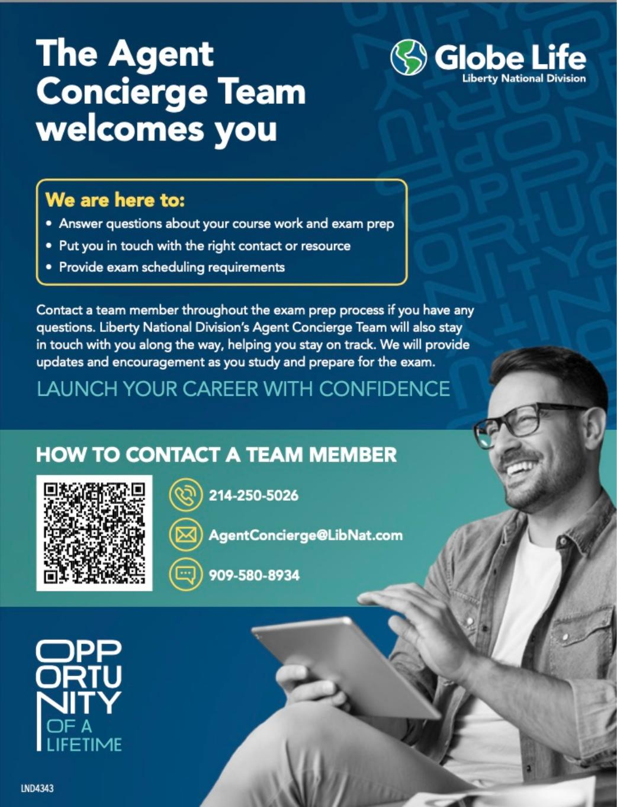
Agent Concierge Team — Your Licensing Support
I am walking with you through every step.
As your Agency Director, I am your primary point of contact throughout this entire onboarding process — reach out to me first with any questions.
The Agent Concierge Team at Liberty National is your secondary resource for exam prep, coursework questions, and exam scheduling requirements.
They will proactively reach out to you after you enroll in coursework — stay in contact and keep moving.
The faster you get licensed, the faster you can get to work — and the more you can earn.
MINDSET

Slide 13
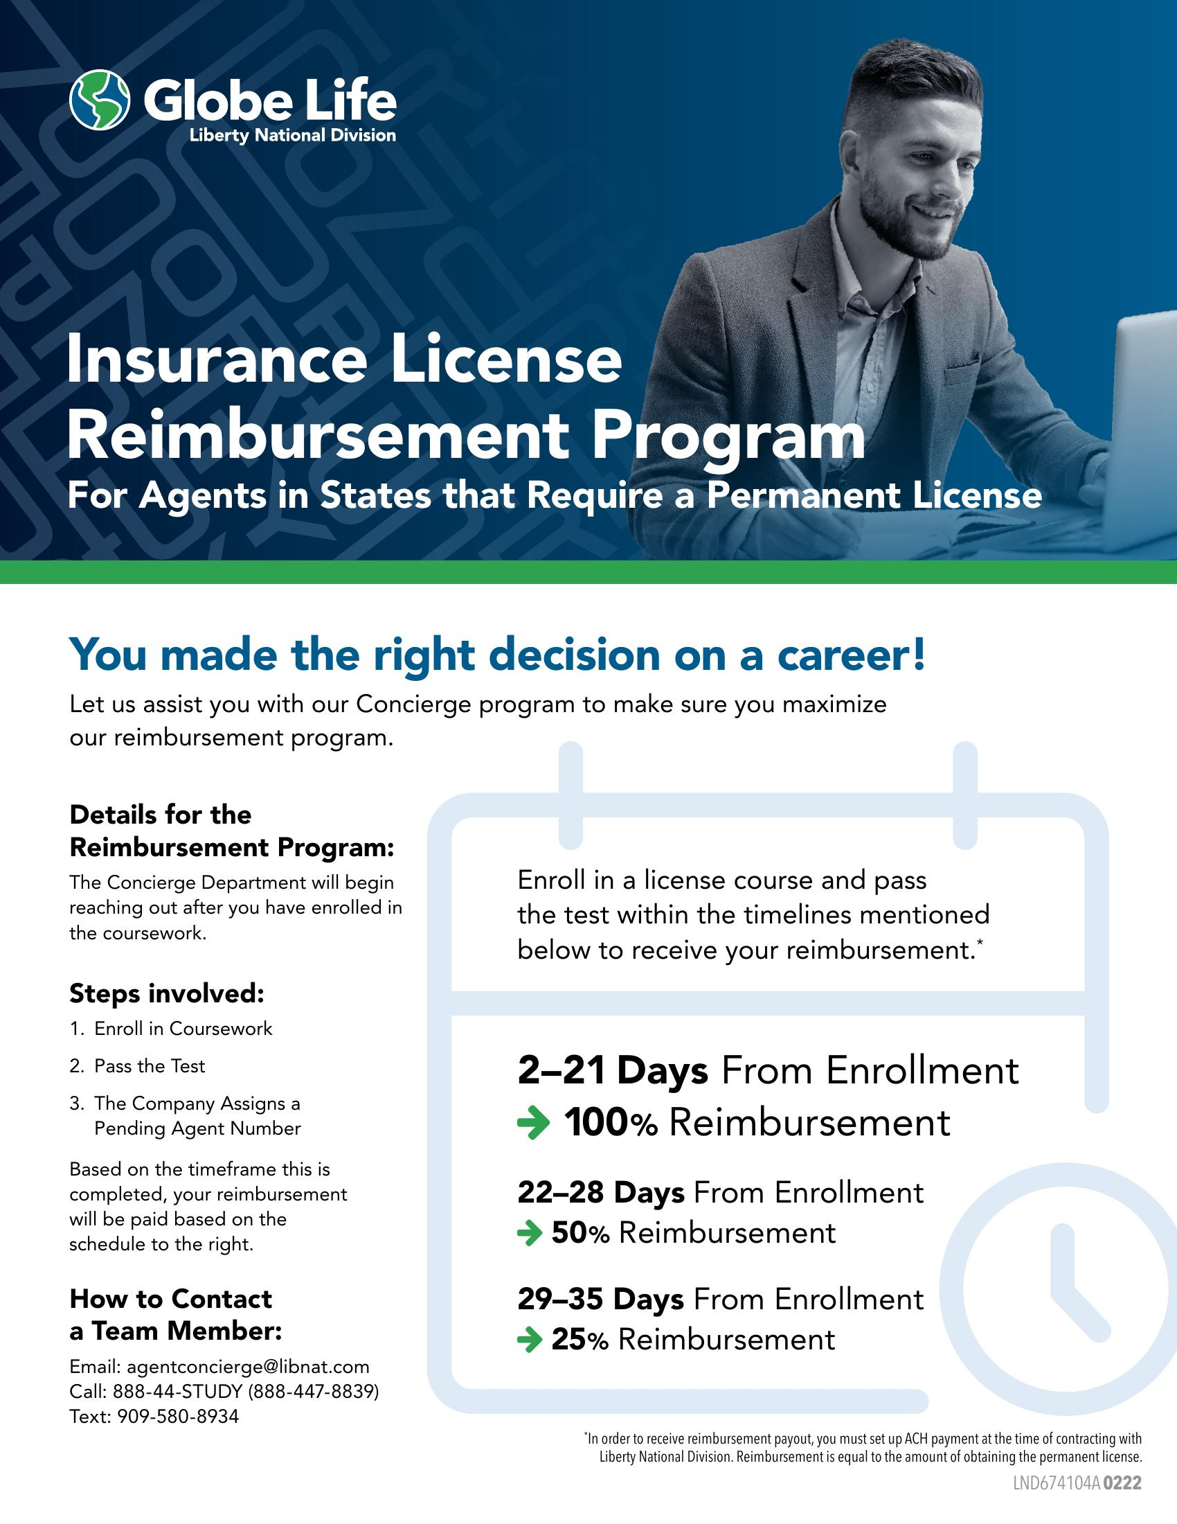
Insurance License Reimbursement Program — Move Fast
Self-study speed = maximum reimbursement.
Enroll in your coursework and pass the exam as quickly as possible — the reimbursement schedule rewards speed.
Days 2–21 from enrollment: 100% reimbursement
Days 22–28: 50% reimbursement
Days 29–35: 25% reimbursement
To qualify: set up ACH payment at the time of contracting with Liberty National Division.
The Concierge Team will reach out after you enroll. Stay responsive and keep pushing.
This is not just about the money — it is about the mindset. Agents who pass fast, start fast.
MINDSET

Slide 14
Let's Get to Work.
I'm in your corner every step of the way. Let's build something great.
MINDSET

